Slide 1
Improve your ASP.NET core web application performance using Azure Cache for Redis
Marc Gravell
Catherine Wang

Slide 2


Speakers
Marc Gravell, Principal Software Engineer
.NET (Distributed Systems) | Microsoft
Maintainer for StackExchange.Redis
Catherine Wang, Senior Product Manager
Azure Cache for Redis | Microsoft

Slide 3
Agenda
Redis and managed Redis service in Azure
How Redis Cache improves application performance
New in .NET 8 – Redis Support for Output Cache
Demo: Web Application + Open AI + Redis Output Cache
Data consistency when using Cache
Demo: PoC for .NET 9 distributed caching
Demo: User session store provider in .NET 8
Overview and tips for using StackExchange.Redis
Demo: StackExchange.Redis for real-time leaderboard

Slide 4
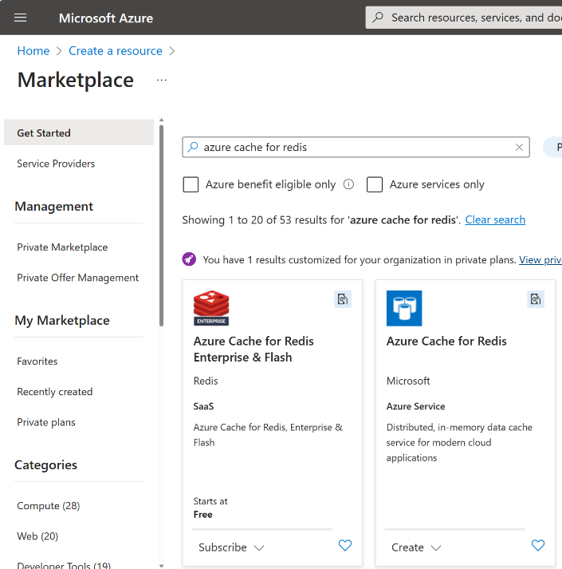
Redis and managed Redis service in Azure
Figure 1: Experience for creating Azure Cache for Redis
Redis
In-memory Key Value store
OSS and Enterprise versions
Azure Cache for Redis
Fully managed
Partnership with Redis Ltd.
Highlights
Performant & scalable
Cost-effective
Secure
Seamless Azure integrations

Slide 5





How Redis Cache improves app performance
http://sample-eshop-web.com/home
3. Session store
Hello, valued customer!
Last viewed items: steamer, cookie cutter
(5)
Assembly:
Microsoft.AspNetCore.Session
Interface:
ISession
Top sold in the past 5 min
Search and filter
1. Web output cache
Assembly:
Microsoft.AspNetCore.OutputCaching
4. Leaderboard
Library:
StackExchange.Redis
2. Distributed cache
Assembly:
Microsoft.Extensions.Caching.Abstractions
Interface:
IDistributedCache

Slide 6





[NEW] - Redis Support for output cache
Figure 1: Workflow for generating a web response without caching
CONSISTENCY
won’t run into different machines having different caches
PERSISTENCE
Serverless applications, containers, etc. won’t start with empty caches.
RESILIENCY
Data is persisted during server failover
RESOURCE EFFICIENCY
Not constrained by the process memory. Memory is scarce resource
4. Generates web responses
Web Output Response
5. Returns web responses
3. Returns responses or data
1. sends a web request
Web Application
2. Calls into dependencies
Dependency Services and APIs
User
Figure 2: Workflow for generating a web response with caching
Web Output Response
(optional) calls the dependencies to generate new web responses when needed
4. Returns web responses
1. sends a web request
Web Application
Dependency Services and APIs
2. Fetches cached web responses
3. Returns cached web responses
Redis

Slide 7
[NEW] - Redis Support for Output Cache
BEFORE
Output-cache did not have Redis implementation
Custom and community implementations exists, but will take effort to maintain and may not be optimized
Figure 1: code snippet for using the output-cache API
app.MapGet("/cached/{prompt}", async (HttpContext context, string prompt, IConfiguration config) => {
await
GenerateImage.GenerateImage(context, prompt, config);
}).CacheOutput();
AFTER
Output-cache now supports Redis Cache in-box!
Well-maintained by the .NET team
Optimized for performance and memory management

Slide 8





Demo: Web Application + Open AI + Redis
Figure 1: Architecture diagram for AI Art Gallery
Figure 2: sample cached output for a purple robot in the cloud
Azure Open AI
user
AI Art Gallery application
AI Art Gallery application
Azure Cache for Redis

Slide 9
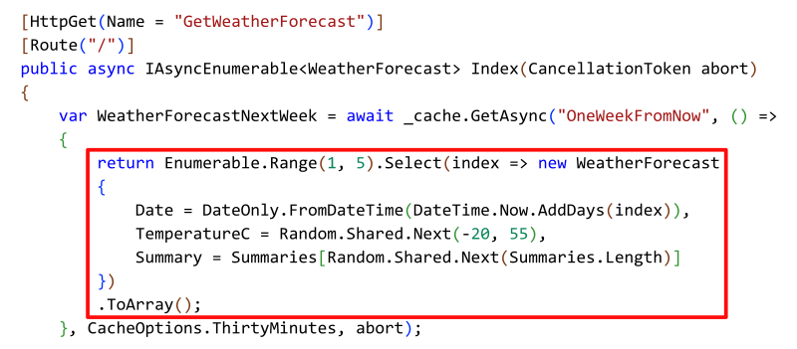
Demo: PoC for .NET 9 distributed caching
Built-in object serialization
defaulting to System.Text.Json, but configurable
Choice of simple and "state" callbacks
Removes repeatable boiler-plate code
Abstract the cache-aside pattern
Figure 1: concept for the next version of Distributed Caching
Source: https://aka.ms/DistributedCachingBlog

Slide 10
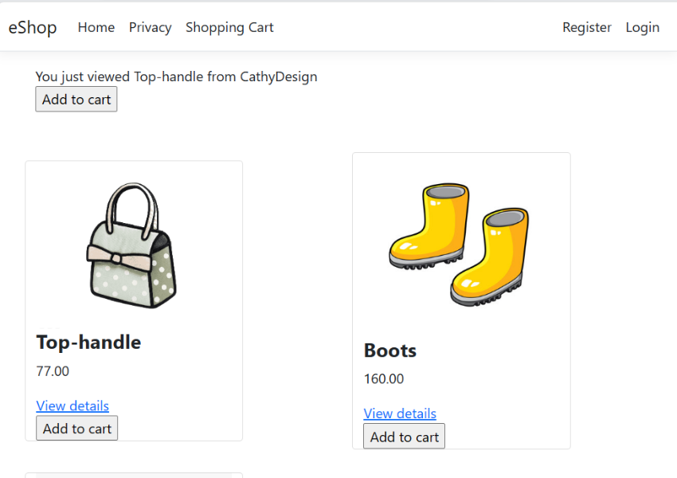
Demo: User session store provider in .NET 8
It is easy to configure session provider using Redis distributed Cache in ASP.NET core!
Figure 1: session data on last viewed items
//Adding Redis Provider for IDistributedCache
builder.Services.AddStackExchangeRedisCache(options =>
{
//configure options
});
//Adding Session Provider, which automatically detects the configured IDistributedCache provider as the session store. In this case, Redis Cache
builder.Services.AddSession(options =>
{
//configure options
});
Session data

Slide 11



StackExchange.Redis
IMPORTANT: always update to the current version of StackExchange.Redis
Rich data type support
Example methods such as:
StringGet() / StringGetAsync() / GeoAdd() / GeoRemove() / GeoDistance() / GeoSearch()/ SortedSetAddAsync()/SortedSetUpdateAsync()…
StackExchange.Redis
Collaboration
Highlights
A high-performance general purpose Redis client for .NET languages (C#, etc.).
Originally developed at Stack Exchange for busy sites like Stack Overflow
Microsoft has been actively working with StackExchange.Redis maintainers to enhance .NET developer experience with Redis Cache
Aspire.StackExchange.Redis
Command Queuing​
Automatic Topology Update
Extensibility
Watch Aspire demo in keynote for using StackExchange.Redis with your Microservice applications!

Slide 12
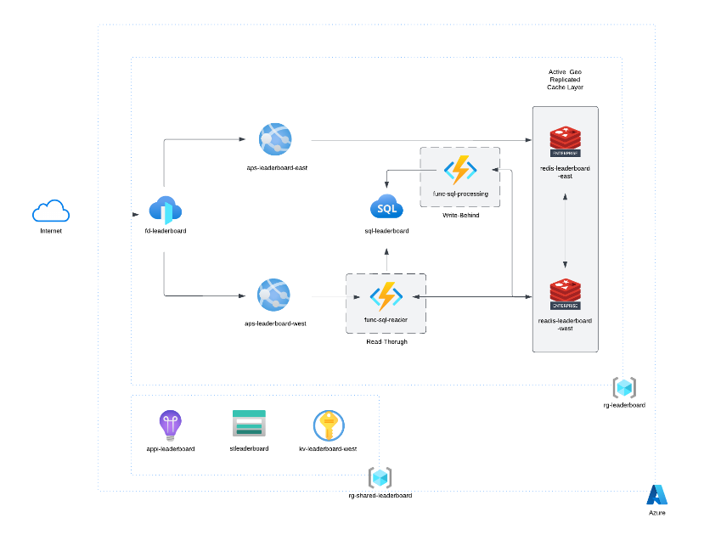
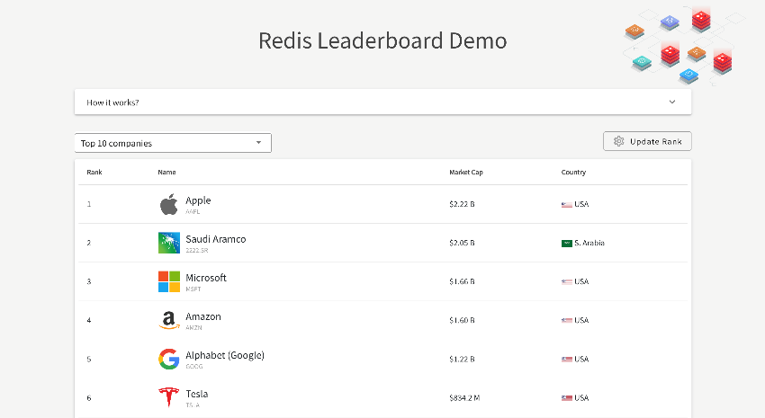
Demo: SE.Redis for real-time leaderboard
Figure 1: architecture diagram for the leaderboard
Figure 2: Redis leaderboard demo homepage
Source: https://learn.microsoft.com/samples/azure-samples/azure-sql-db-redis/azure-sql-db-redis/
Author: Davide Mauri (Microsoft), Roberto Perez (Redis Ltd.)

Slide 13
Thank you!
Download .NET 8: https://aka.ms/get-dotnet-8
Try output-caching with Redis support
https://aka.ms/redis-cache/outputcaching
Demo code:
https://aka.ms/redis-cache/outputcache-openai-demo
https://aka.ms/redis-cache/eshop
https://aka.ms/redis-cache/leaderboard
Previous blog on distributed caching:
https://aka.ms/DistributedCachingBlog

